Slide 1



Institute of Emerging Careers
Learn. Earn. Contribute.
RFM Analysis For Successful Customer Segmentation
Presented By: Jawad Ahmad
Email: jawadrafay7@gmail.com

Slide 2

GROCERY STORE
“Want to Increase Sales”
Using Marketing
What Will Be Most Suitable The Medium For Marketing
But these mediums are so expensive and ROI is very shaky We can’t Afford this
mediums
Television
Ads
Newspaper Ads
Social Media Ads

Slide 3
CUSTOMER ACQUISTION VS RETENTATION MARKETING
We Can Retain Our Existing Customers Using
“Target Marketing”
CUSTOMER ACQUISITION
The success rate of selling to a new customer is
RETENTATION
The success rate of selling to a customer you already have is 60-70%.
5-20%.

Slide 4

UNDERSTAND YOUR CUSTOMERS
EVERY CUSOMER IS DIFFERENT
WHAT WE NEED TO DO KNOW ??
UNDERSTAND CUSTOMER BEHAVIOUR IN PAST

Slide 5
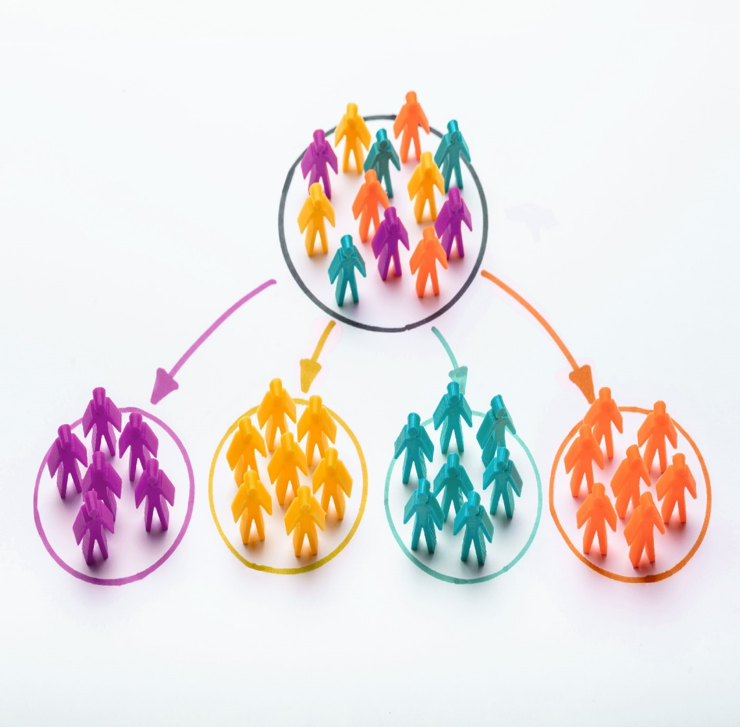
RFM SEGMENTATION
“ RFM Segmentation is a marketing technique used to Quantitatively rank and group customers based on the nature of their spending habits. ”
how recently did they bought
how much did they buy.
how often did they bought
It groups customers based on their transaction history

Slide 6
METRICS FOR RFM
Recency:
How recently a customer has made a purchase
RECENCY
MONETARY
FREQUENCY
Frequency:
How often a customer has made a purchase
Monetary:
How much money a customer spends on a purchase

Slide 7
RFM ANALYSIS IMPORTANCE
WHY RFM ANALYSIS IS IMPORTANT FOR BUSINNESS
OPTIMIZING
MARKETING
BUDGET
INCREASING CONVERSATION
RATE
PERSONALIZATION
OF
MARKETING
STRATEGIES
INCREASE REVENUE
AND
PROFITS
IDENTIFICATION OF YOUR BEST
CUSTOMERS

Slide 8
RFM ANALYSIS HELPS ANSWERS THIS QUESTIONS
Who are the loyal customers of a store?
Which customers have the potential to convert into regular profitable customers?
Which customers a store must retain?
Which group of customers is most probable to respond to your campaign?
Who are the churned out customers and who are about to churn?

Slide 9
STEPS OF RFM ANALYSIS
1
3
4
2
ASSEMBLE RELEVANT DATA
RFM TABLE
SCORE DESIGNATION
SEGMENTS CLASSIFICATION

Slide 10
1 - RELEVANT DATA FOR
RFM ANALYSIS
CUSTOMER ID
TRANSACTION DATE/TIME
AMOUNT OF TRANSACTION

Slide 11
2 - SETTING RFM TABLE
THIS STEP INCLUDES:
SUMMARIZING DATA FOR CALCULATIONS OF:
RECENCY (DAYS SINCE LAST PURCHASE),
FREQUENCY (TOTAL NO OF TRANSACTIONS),
MONETARY (TOTAL TRANSACTIONS AMOUNT)
SCORE | RECENCY | FREQUENCY | MONETARY
1 | LAST BOUGHT A YEAR AGO | BOUGHT ONCE A YEAR | LESS THAN 1000
2 | LAST BOUGHT 9 MONTHS AGO | BOUGHT THRICE A YEAR | 1001-3000
3 | LAST BOUGHT 3 MONTHS AGO | BOUGHT 7 TIMES A YEAR | 3000-10000

Slide 12
3 - SCORE DESIGNATION
QUINTILES DIVISION:
SCORE DESIGNATION:
ASSIGNING SCORE 1-5 TO THIS QUINTILES.
5 TO HIGHEST FREQUENCY,MONETARY AND LOWEST RECENCY CLASS AND 1 TO LOWEST FREQUENCY, MONETARY AND HIGHEST RECENCY CLASS
DIVISION OF CUSTOMERS INTO FIVE EQUAL CATEGORIES USING QUINTILES.
EACH CLASS IS COMPOSED OF EQUAL 20% CUSTOMERS ON THE BASIS OF RFM VARIABLES

Slide 13
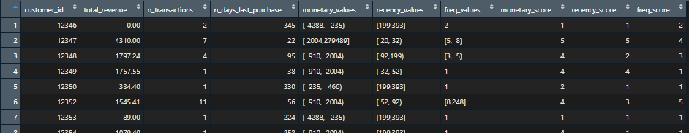
3 - SCORE DESIGNATION
QUINTILES DIVISION:
SCORE DESIGNATION:

Slide 14
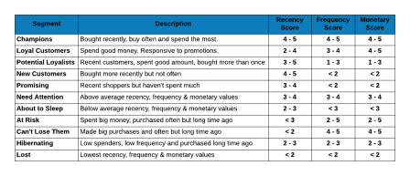
4 - SEGMENTS CLASSIFICATION
HERE IS AN EXAMPLE OF A RFM SEGMENTS TABLE WITH 11 SEGMENTS OF CUSTOMERS BASED ON THEIR RFM SCORES
RFM SEGMENTATION TABLE

Slide 15
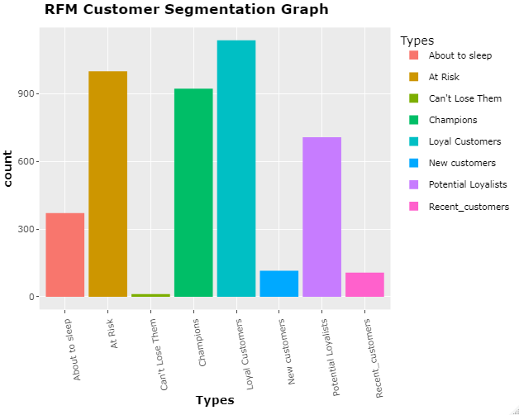
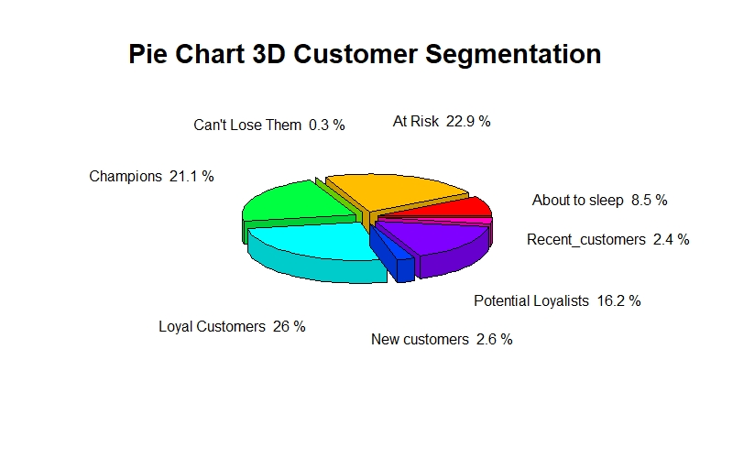
RFM ANALYSIS VISUALIZATIONS

Slide 16
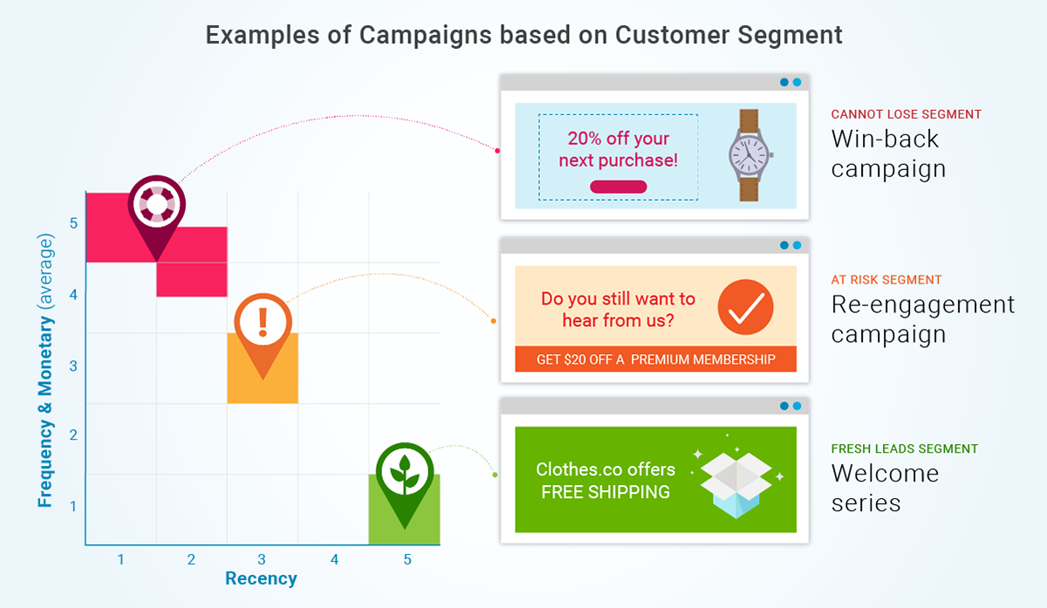
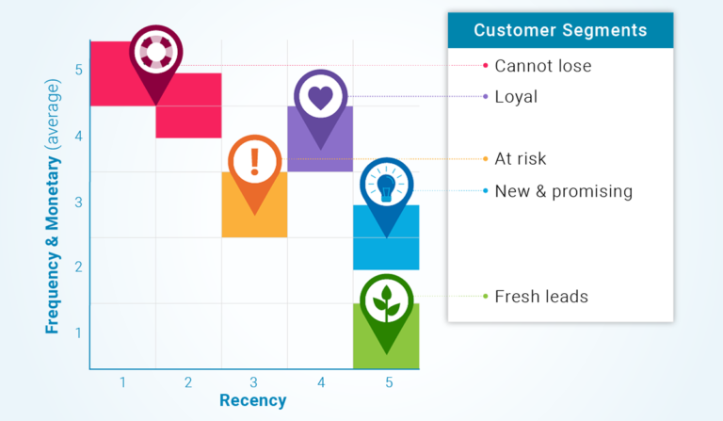
RFM STRATEGIC APPROACH:
AFTER KNOWING THE CUSTOMERS TYPE WE CAN DEVISE THE RELEVANT MARKETING STRATEGY FOR GETTING BACK OUR EXISTING CUSTOMERS

Slide 17
Institute of Emerging Careers
Learn. Earn. Contribute.
THANK YOU
FOR BEING WITH US !
QUESTIONS?
Email: jawadrafay7@gmail.com

